Slide 1

SQL CHALLENGE 2
E-SPORTS TOURNAMENT

Slide 2
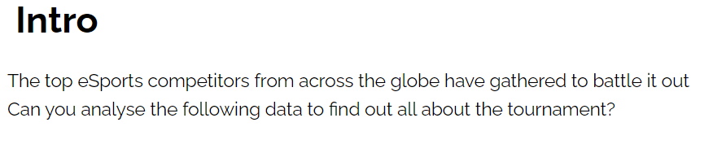

Slide 3
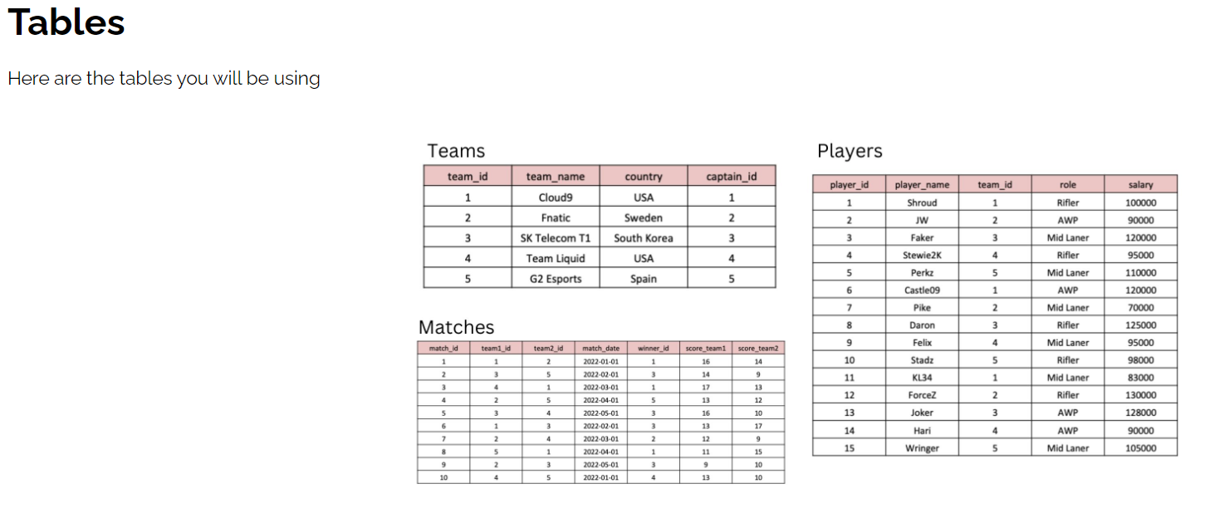

Slide 4
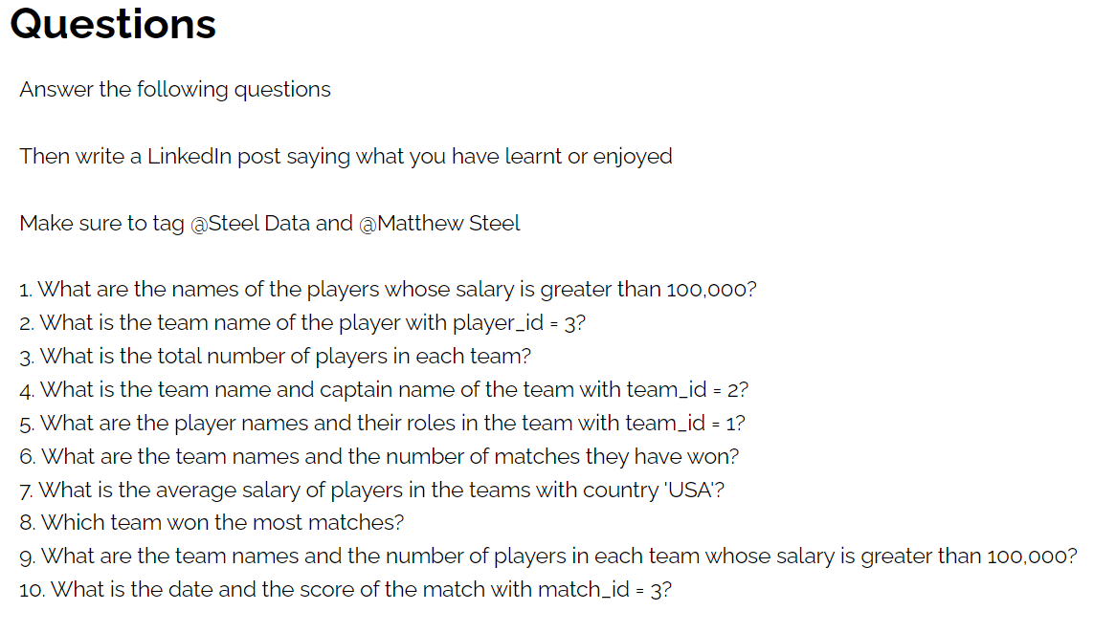

Slide 5
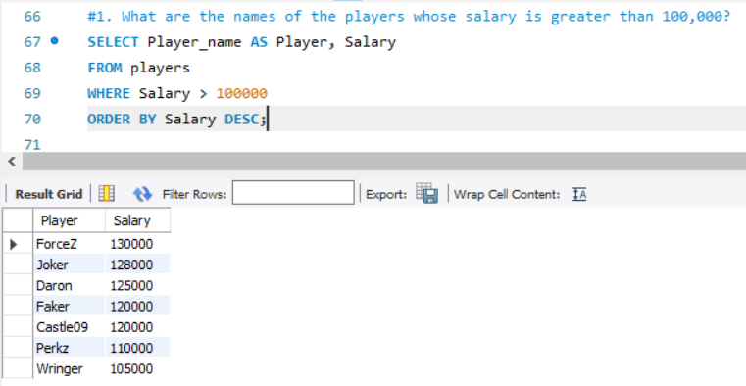

Slide 6
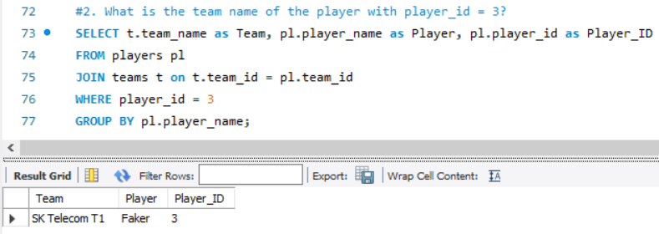

Slide 7
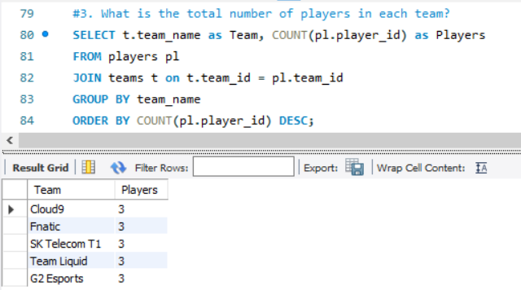

Slide 8
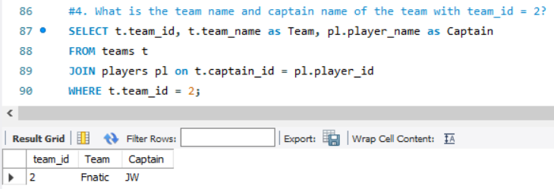

Slide 9
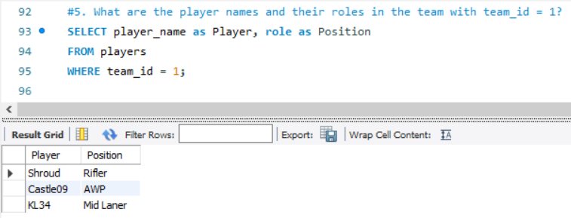

Slide 10
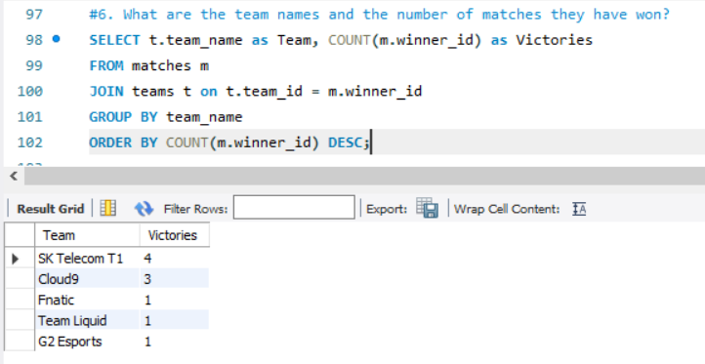

Slide 11
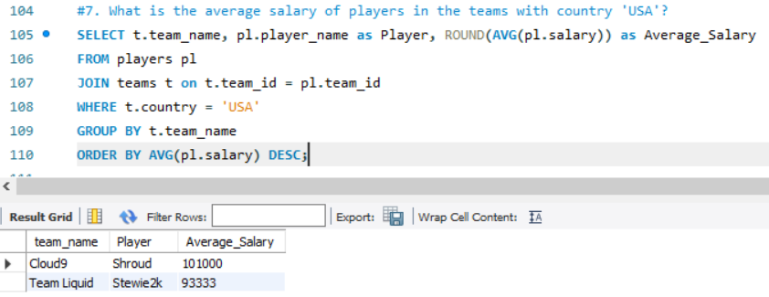

Slide 12
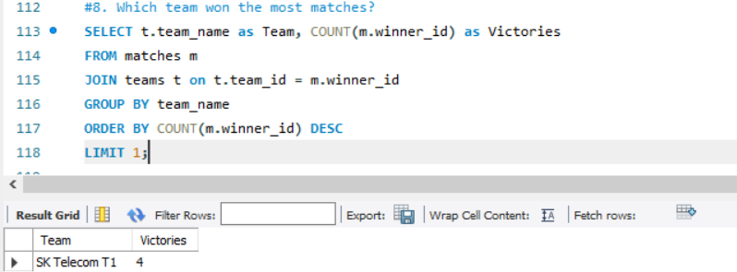

Slide 13
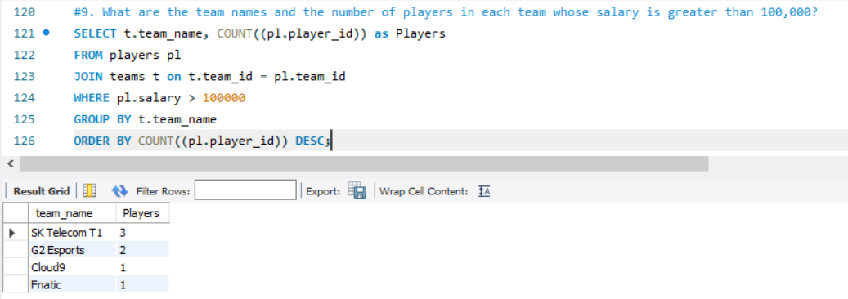

Slide 14
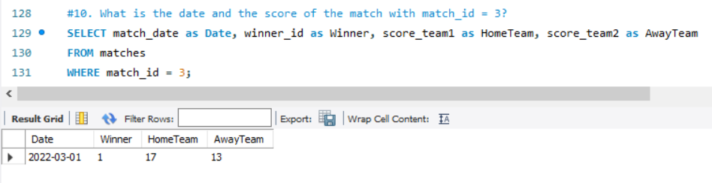

Slide 15
INSIGHTS
Players Forcez, Joker and Daron are TOP 3 out of 7 players with salaries over 100000.
The teams listed happen to have 3 players each.
SK Telecom 1 is the team which have the most victories with 4 matches won.
SK Telecom 1 team has 3 player with salaries higher than 100000.

